Slide 1
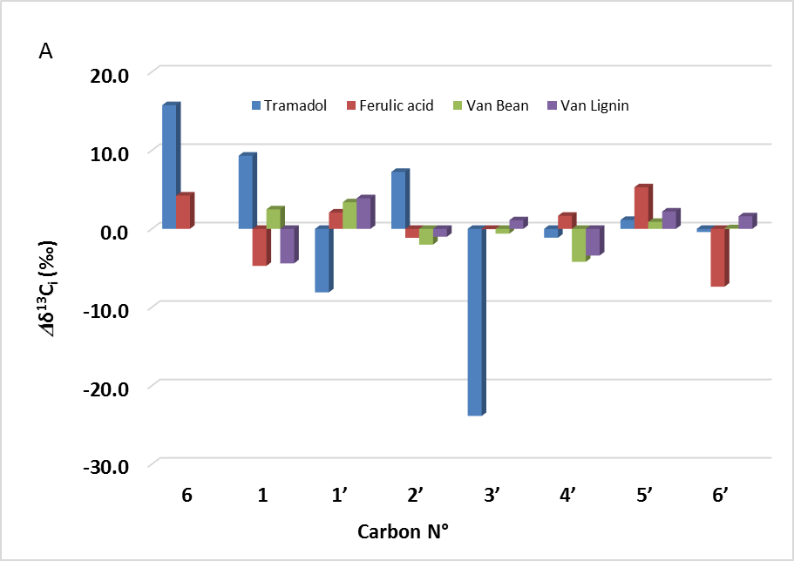
Position-Specific Isotope Analysis – a retro-biosynthetic approach to elucidate and
predict biosynthetic pathways as shown for Tramadol.
K. M. Romek, P. Nun, G. S. Remaud, V. Silvestre, G. Sotoing Taïwe, F. Lecerf-Schmidt,
Boumendjel, M. De Waard, Richard J. Robins.
Proc. Natl. Acad. Sci. U. S. A., 2015, 112, 8296-301.

